Slide 1
Unit II
Instruction set architecture & computer organization

Slide 2
Microprocessor
The 8085 is an 8-bit microprocessor introduced by Intel in 1976.The 8085 was the follow-on processor to the very successful Intel 8080A processor. The 8085 got its name because it was Intel’s first 5 volt microprocessor. The 8085 was 100% software compatible with the 8080A with increased systems performance. The initial 8085’s were based on NMOS technology and the later “H” versions were based on HMOS technology. The 8085 used 6,500 transistors. The 8085 incorporated all the features of the 8224 (clock generator) and the 8228 (system controller) increasing the level of system integration.
Features
(i) Introduced-March 1976
(ii) Clock rate-5 MHz
(iii) 0.37 MIPS
(iv) Bus Width-8 bits data, 16 bits address
(v) Depletion load-NMOS logic
(vi) Number of Transistors-6,500 at 3 μm
(vii) Binary compatible downwards with the 8080.
(viii) Used in Toledo scale. Also was used as a computer peripheral controller - modems, hard disk, printers, etc.
(ix) High level of integration, operating for the first time on a single 5 volt power supply, from 12 volts previously. Also featured serial I/O, 3 maskable interrupts, 1 Non-maskable interrupt, 1 externally expandable interrupt [8259], status, DMA.

Slide 3
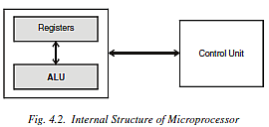
microprocessor
The microprocessor has three major components, namely Registers, Arithmetic and Logic Unit (ALU) and Control Unit (CU) as shown in the Fig. 4.2. Registers are used to store the data temporarily during the execution of the instruction. There are two types of registers namely general purpose registers and special purpose registers.

Slide 4
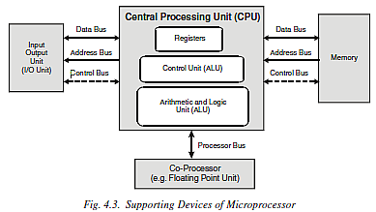
Supporting devices

Slide 5
Assignment II
What is DMA ?
What is the difference between DRAM and SRAM ?
List Distinctive features of 8085 Microprocessor.
Explain with the help of Diagram the functioning of Control Unit of a Microprocessor

Slide 6
Programming languages
A programming language is a notation for writing programs, which are specifications of a computation or algorithm
Machine Language
Low-level Language
High Level Language

Slide 7
Assembly language
Assembly language is the symbolic representation of machine code, which also allows symbolic designation of memory locations. Thus, an instruction to add the contents of a memory location to an internal CPU register called the accumulator might be add a number instead of a string of binary digits (bits).No matter how close assembly language is to machine code, the computer still cannot understand it.

Slide 8
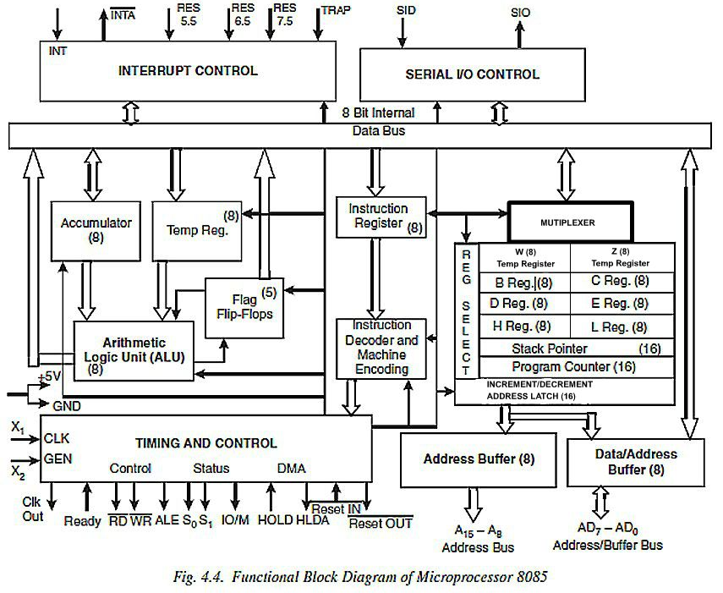

Slide 9
8085
REGISTERS
The 8085 can access 2¹⁶ (= 65,536) individual 8-bit memory locations, or in other words, its address space is 64 kb. Unlike some other microprocessors of its era, it has a separate address space for up to 2⁸ (=256) I/O ports.
It also has a built in register array which are usually labeled A (Accumulator), B, C, D, E, H, and L. Further special-purpose registers are the 16-bit Program Counter (PC), Stack Pointer (SP), and 8-bit flag register F.
ACCUMULATOR
The accumulator is an 8-bit register that is a part of arithmetic/logic unit (ALU). This register is used to store 8-bit data and to perform arithmetic and logical operations. The result of an operation is stored in the accumulator. The accumulator is also identified as register A.
REGISTER PAIR
(1) 8-bit B and 8-bit C registers can be used as one 16-bit BC register pair. When used as a pair, the C register contains low-order byte. Some instructions may use BC register as a data pointer.
(2) 8-bit D and 8-bit E registers can be used as one 16-bit DE register pair. When used as a pair the E register contains low-order byte. Some instructions may use DE register as a data pointer.
(3) 8-bit H and 8-bit L registers can be used as one 16-bit HL register pair. When used as a pair the L register contains low-order byte. HL register usually contains a data pointer used to reference memory addresses.

Slide 10
8085
STACK POINTER
Stack pointer is a 16 bit register. This register is always incremented/decremented by 2. It always holds the address of the top most entity in the stack. The stack pointer is also used as a memory pointer. It points to a memory location in R/W memory, called the stack. The beginning of the stack is defined by loading 16-bit address in the stack pointer.
PROGRAM COUNTER
Program counter is a 16-bit register. It holds the address of the instruction which is to be executed next.
INSTRUCTION REGISTER / DECODER
Temporary storage for the current instruction of a program. Latest instruction sent here from memory prior to execution. Decoder then takes instruction and ‘decodes’ or interprets the instruction. Decoded instruction then passed to next stage.

Slide 11

8085
MEMORY ADDRESS REGISTER
It holds the address (received from PC) of next program instruction. Feeds the address bus with addresses of location of the program under execution.
FLAG REGISTER
The ALU includes five flip-flops, which are set or reset after an operation according to data conditions of the result in the accumulator and other registers. They are called Zero (Z), Carry (CY), Sign (S), Parity (P), and Auxiliary Carry (AC) flags; and their bit positions in the flag register are shown below.
The most commonly used flags are Zero, Carry, and Sign. The microprocessor uses these flags to test data conditions.
For example, after an addition of two numbers, if the sum in the accumulator is larger than eight bits, the flip-flop uses to indicate a carry, called the Carry flag (CY) – is set to one. When an arithmetic operation results in zero, the flip-flop called the Zero (Z) flag is set to one.

Slide 12
8085 System bus
Typical system uses a number of busses, collection of wires, which transmit binary numbers, one bit per wire. A typical microprocessor communicates with memory and other devices (input and output) using three busses: Address Bus, Data Bus and Control Bus.
1. Address Bus: One wire for each bit, therefore 16 bits = 16 wires. Binary number carried alerts memory to ‘open’ the designated box. Data (binary) can then be put in or taken out. The Address Bus consists of 16 wires, therefore 16 bits. Its “width” is 16 bits. A 16 bit binary number allows 216 different numbers, or 32000 different numbers, i.e., 0000000000000000 up to 1111111111111111. Because memory consists of boxes, each with a unique address, the size of the address bus determines the size of memory, which can be used. To communicate with memory the microprocessor sends an address on the address bus, e.g. 0000000000000011 (3 in decimal), to the memory. The memory selects box number 3 for reading or writing data. Address bus is unidirectional, i.e., numbers only sent from microprocessor to memory, not other way.

Slide 13
8085 System bus
Typical system uses a number of busses, collection of wires, which transmit binary numbers, one bit per wire. A typical microprocessor communicates with memory and other devices (input and output) using three busses: Address Bus, Data Bus and Control Bus.
2. Data Bus: Data bus carries ‘data’, in binary form, between microprocessor and other external units, such as memory. Typical size is 8 or 16 bits. Size determined by size of boxes in memory and microprocessor size helps determine performance of microprocessor. The Data bus typically consists of 8 wires. Data bus used to transmit “data”, i.e. information, results of arithmetic, etc. between memory and the microprocessor. Bus is bi-directional. Size of the data bus determines what arithmetic can be done. If only 8 bits wide then largest number is 11111111 (255 in decimal). Therefore, larger numbers have to be broken down into chunks of 255. This slows microprocessor. Data bus also carries instructions from memory to the microprocessor. Size of the bus therefore limits the number of possible instructions to 256, each specified by a separate number.

Slide 14
8085 System bus
Typical system uses a number of busses, collection of wires, which transmit binary numbers, one bit per wire. A typical microprocessor communicates with memory and other devices (input and output) using three busses: Address Bus, Data Bus and Control Bus.
3. Control Bus: Control Bus has various lines which have specific functions for coordinating and controlling microprocessor operations. Control whether memory is being ‘written to’ (data stored in memory) or ‘read from’ (data taken out of memory) 1 = Read, 0 = Write. May also include clock line(s) for timing/synchronizing, ‘interrupts’, ‘reset’, etc. generally microprocessor has 10 control lines. The Control Bus carries control signals partly unidirectional, partly bi-directional. Control signals are things like “read or write”. This tells memory that we are reading from a location, specified on the address bus, or writing to a location specified. Modern day microprocessors, like 80386, 80486 have much larger busses. Typically 16 or 32 bit busses, which allow larger number of instructions, more memory location, and faster arithmetic.

Slide 15
PIN CONFIGURATION
Microprocessor 8085 is available in 40 pin DIP package shown in Fig. 4.5. The 8085 has some following properties these are:
1. Single + 5V Supply
2. 4 Vectored Interrupts (One is Non Maskable)
3. Serial In/Serial out Port
4. Decimal, Binary, and Double Precision Arithmetic
5. Direct Addressing Capability to 64K bytes of memory

Slide 16
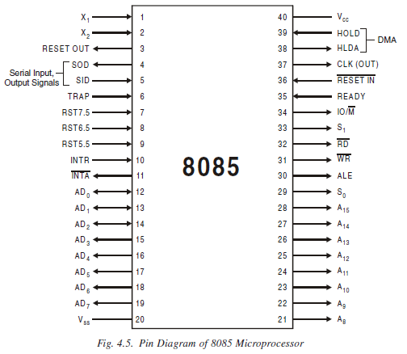

Slide 17
ADDRESSING MODES
1. Immediate addressing.
2. Register addressing.
3. Direct addressing.
4. Indirect addressing.

Slide 18
Immediate addressing
Data is present in the instruction. Load the immediate data to the destination provided.
Example: MVI R, data

Slide 19
Register addressing
Data is provided through the registers.
Example: MOV Rd, Rs

Slide 20
Direct addressing
Used to accept data from outside devices to store in the accumulator or send the data stored in the accumulator to the outside device. Accept the data from the port 00H and store them into the accumulator or Send the data from the accumulator to the port 01H.
Example: IN 00H or OUT 01H

Slide 21
Indirect addressing
This means that the Effective Address is calculated by the processor and the contents of the address (and the one following) is used to form a second address. The second address is where the data is stored. Note that this requires several memory accesses; two accesses to retrieve the 16-bit address and a further access (or accesses) to retrieve the data which is to be loaded into the register.

